Slide 1
Deep Learning
Main Concepts

Slide 2
Why deep learning?
Simple machine learning algorithms are not adequate to map very high level of nonlinearity
Traditional machine learning algorithms assumes that the features are uncorrelated with each other (e.g. KNN, SVM) which are not true in many situations
Voice recognition
Face recognition
Image classification etc
To extract patterns from such highly nonlinear unstructured data, deeper neural network structures are required

Slide 3
Why deep learning?
Deep learning can make AI (Artificial Intelligence) even superior in future
Self driving cars (already available)
Intelligent robots
Medical report diagnosis
Self driving drones for aerial defence
Deep learning systems have shown superior capabilities in many areas where human failed:
AI beats human in Poker game, Chess, Go and Super Smash Bros.
Beats humans in Image recognition challenge (ImageNet competition)

Slide 4

Why deep learning?
It can create abstract images through over processing
It can create music as well (hear it) (Google’s Magenta Project)
Quite successful in language translation
And it’s just the beginning!

Slide 5
What is deep learning?
Big brother of simple neural network structure (simple perceptron and simple MLP)
The network structure may contain even 100 hidden layers
Highly computationally intensive process
Needs support of GPUs for faster execution of processes
Specialized libraries are needed such as Theano, Keras, TensorFlow, Mxnet etc

Slide 6
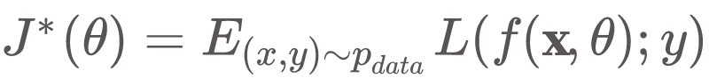
Fundamental concepts
Basic idea in learning is to minimize a cost function L over the data generating distribution P_{data}
In reality what we do is Empirical Risk Minimization as we work with only a training data set

Slide 7
Fundamental concepts
Training usually happens in smaller batches and that gives an idea of stochastic learning rather than full batch learning
Gradient estimated by full batch gradient learning is more accurate but takes lots of time in processing
Minibatch sizes are determined by a few factors such as:
Accuracy vs speed
Usage of multicore facilities
Available physical memory
Availability of GPU

Slide 8
Fundamental concepts
Optimization in neural network is a challenging task due to a few critical issues
Ill Conditioning
Local Minima
Plateaus and saddle points
Exploding and Vanishing gradient
Poor correspondence between local and global structures

Slide 9
Fundamental concepts
Ill conditioning poses a problem when the even a small step in SGD causes the cost function f(x) value to increase
Value of cost function at (x-ηg) is approximated as
Ill conditioned hessian will make the learning process slow

Slide 10
Fundamental concepts
Deep neural network (DNN) cannot use sigmoid function in its simplest form as in case of MLP with single hidden layer
In its simplest form, sigmoid function as the activation function makes DNN to suffers from two very critical issues
Vanishing gradient
Exploding gradient (usually seen in RNN)

Slide 11
Fundamental concepts
Vanishing gradient:
Gradient descent algorithm calculates gradients during backpropagation so as to update the weights of neural links between layers
As the number of hidden layer increases, the gradients, often, starts getting smaller and smaller for the layers in the lower levels
Smaller gradients practically doesn’t update the earlier weights which leads to suboptimal performance

Slide 12
Fundamental concepts
Exploding gradient:
Just like vanishing gradient issue during backpropagation, exploding gradient is another issue when the gradient starts increasing in each layer leading to very high value of gradient
In such a situation the model diverges giving a very bad model

Slide 13
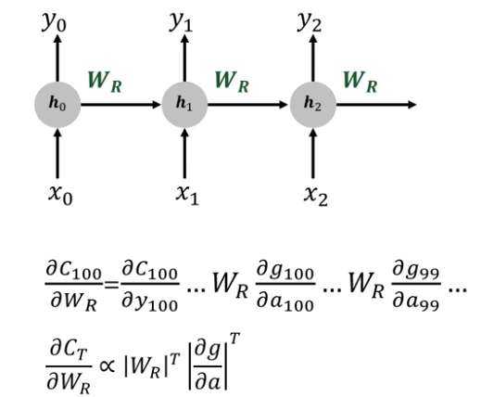
Fundamental concepts
Issue of vanishing and exploding gradient can be understood in the context of RNN in the shown figure
If w_{R} is less than 1, vanishing gradient issue will creep in whereas if it is above 1 then exploding gradient will diverge the model
It is the long term dependency that creates the exploding and vanishing gradients in RNN

Slide 14
Fundamental concepts
Dealing with vanishing and exploding gradient issues:
Use different activation functions (non-saturating)
ReLU (Rectified Linear Unit)
Leaky ReLU
ELU (Exponential Linear Unit)
Use different weight initialization
Xavier initialization (logistic/sigmoid function)
He initialization (ReLU initialization)
Use Batch Normalization technique (preferred method in DNN)

Slide 15
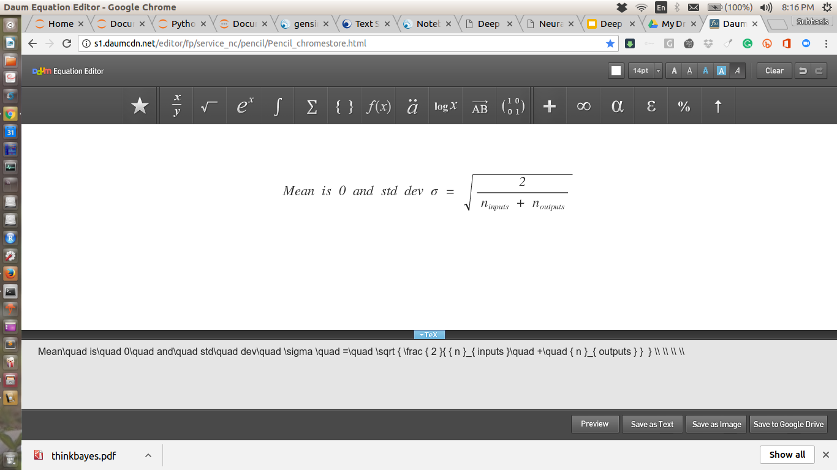
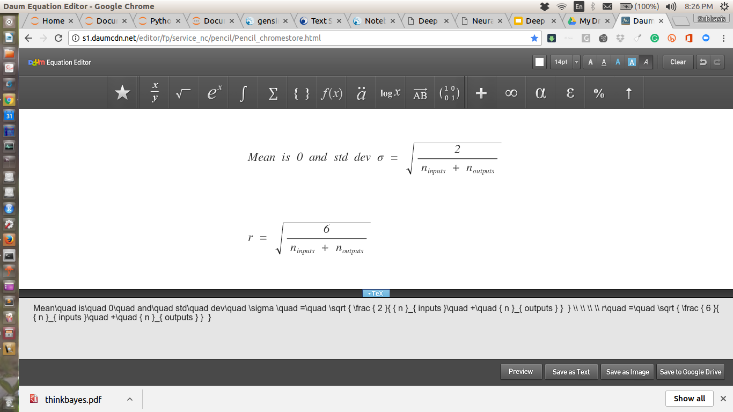
Xavier initialization
When logistic function is used, Xavier initialization provides much better result in keeping the gradients from getting either vanished or exploded
If random initialization is done using a normal distribution
If random initialization is done using a uniform distribution between -r and +r

Slide 16
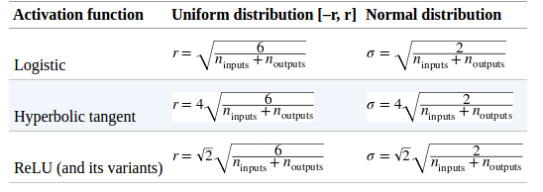
He Initialization parameters (ReLU activation)

Slide 17
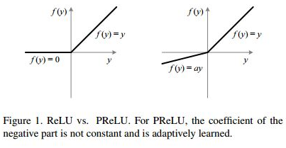
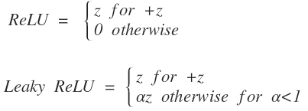
Non-saturating Activation Function
Logistic and Hypertangent functions are saturating at the high and low values
This is overcome by using ReLU activation which does not saturate for positive values
However, ReLU makes quite some problem by keeping some neuron dead because the function returns 0 value for -ve values

Slide 18
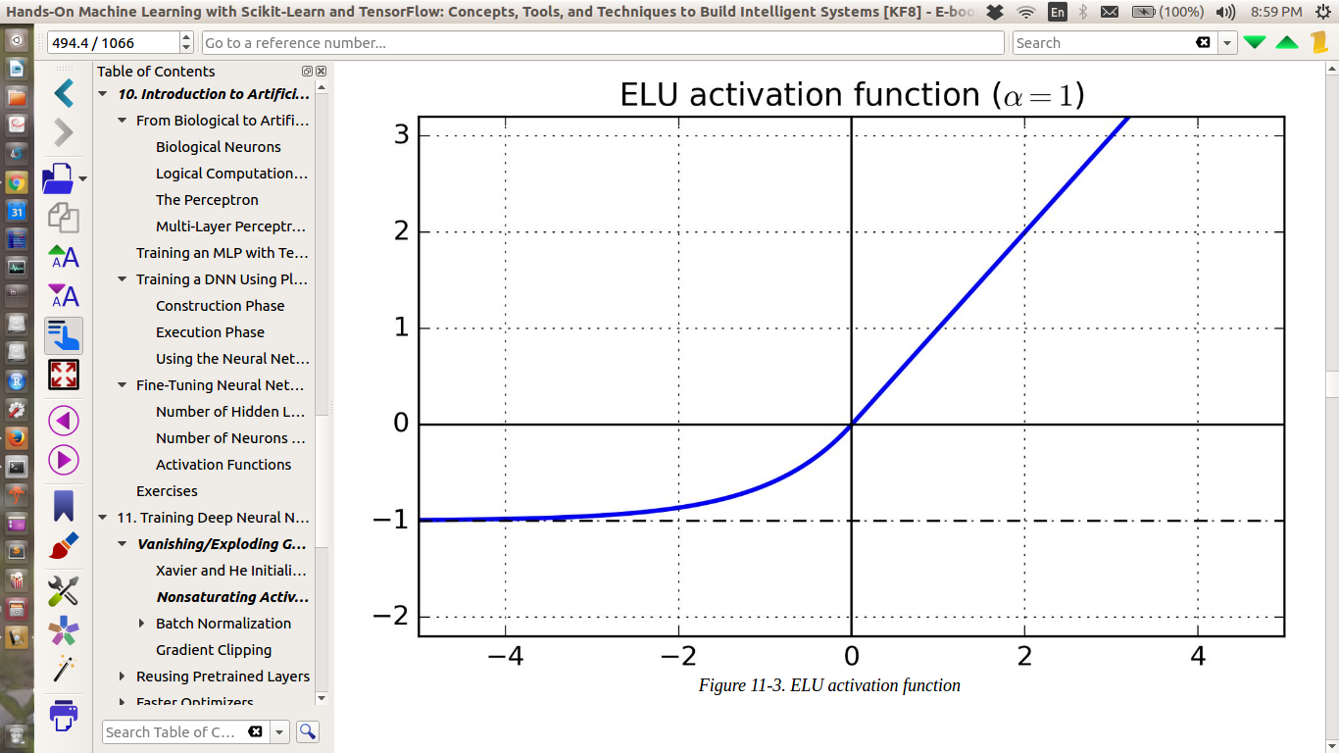
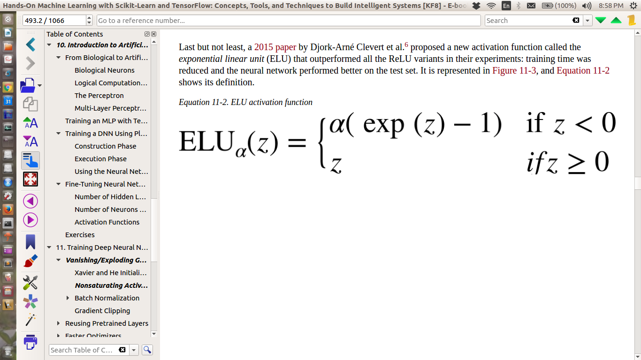
Non-saturating Activation Function
Another useful activation function is ELU (Exponential Linear Unit)
Takes -ve values unlike ReLU
Non zero gradient at z<0
Smooth everywhere including around z=0 helping speeding gradient descent
However, slow compared to ReLU

Slide 19
Batch Normalization
It involves adding an extra operation just before the activation function
Zero centering and normalizing the inputs
Scaling and shifting the result using two new parameters per layer (one for scaling and other for shifting)
In other words, this operation lets the model learn the optimal scale and mean of the inputs for each layer
It uses small batch of samples (or instances) to calculate mean and standard deviation for doing scaling and shifting (hence got the name Batch Normalization)

Slide 20
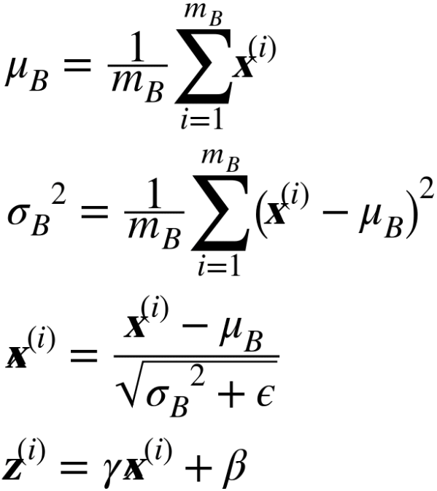
Batch Normalization
Batch normalization proceeds through these steps:
μ_{B} is the empirical mean evaluated over the mini-batch
σ_{B} is the standard deviation
m_{B} is the mini-batch size
𝛾 is the scaling parameter for the layer
𝛽 is the shifting parameter
𝝐 is the smoothing parameter to avoid divided by zero condition (small value such as 10⁻³)
z^{(i)} is the output of the batch normalization operation

Slide 21
Optimizers
Simple Gradient Descent method can be used in MLP having single hidden layer but this technique would be very slow in case of deep networks
For faster optimization, the following optimizers can be used:
Momentum optimization
Nesterov Accelerated Gradient
AdaGrad
RMSProp
Adam Optimization

Slide 22
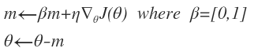
Momentum optimization
It resembles rolling down a ball down the hill which takes up momentum
Regular gradient descent slides down the steep slope quickly but proceeds very slowly in the valley portion of any error surface
Momentum optimization, due to its momentum term passes the valley portions rather quickly
This optimization contains a hyper-parameter 𝛽 thats acts like a friction to control the momentum

Slide 23
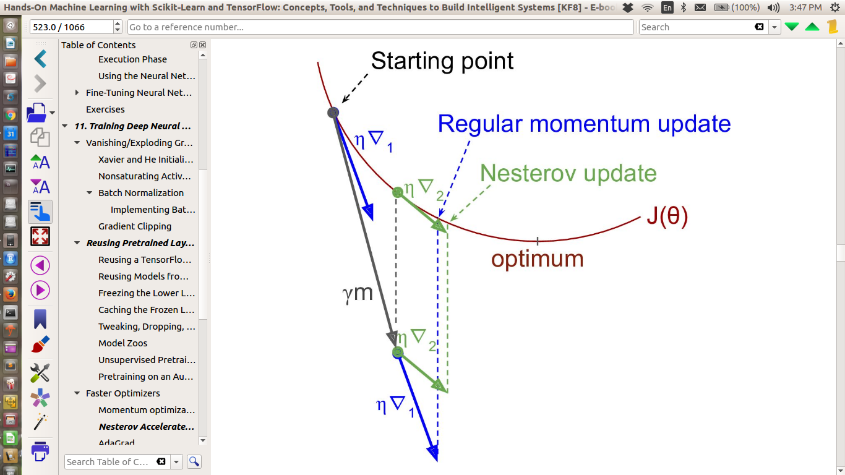
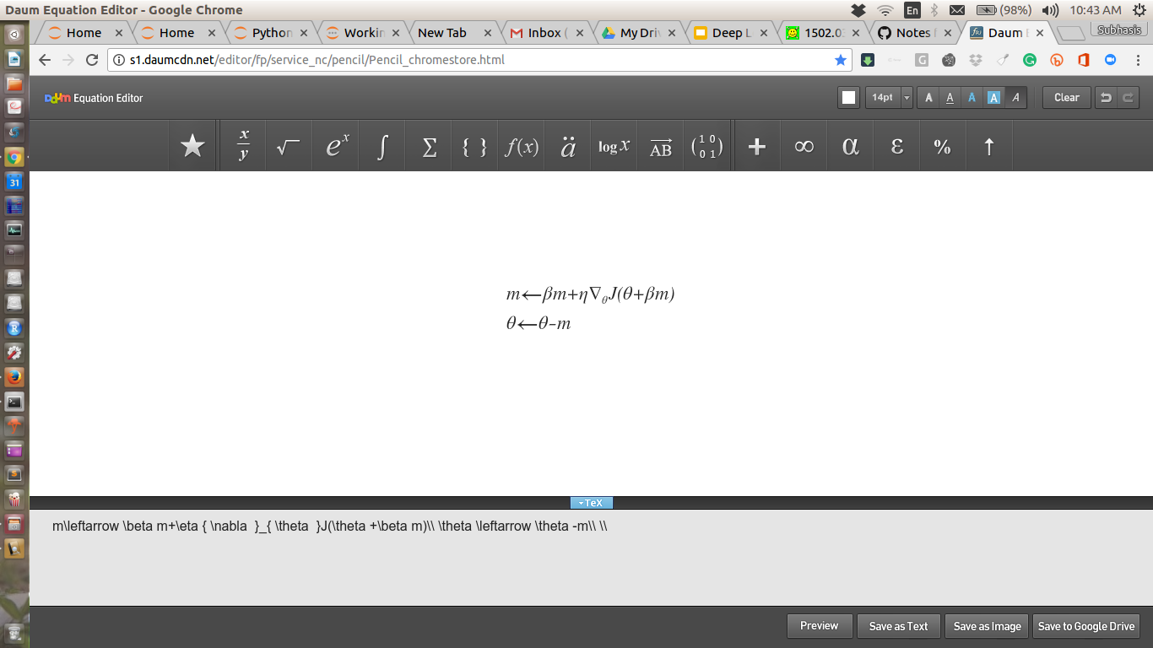
Nesterov Accelerated Gradient
It is a modified version of simple Momentum Optimization
Error function is a function of parameters 𝜃 + 𝜷m where 𝜷m is the slight offset along the direction of the momentum
Due to this shift, the algorithm approaches optimum value rather faster than simple momentum optimization technique

Slide 24
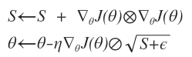
AdaGrad
It tries to adapt the learning rate as it encounters different regions of error surface to move towards global optima
It is achieved by means of scaling the gradient vector along the steepest dimension
The scaling is simple squaring the gradient terms and the updation happens as shown below
Element wise multiplication
Smoothing factor 10⁻⁵ or so
Element wise division

Slide 25
AdaGrad
AdaGrad works well for simple quadratic problems
Not very effective in training neural networks due to quick convergence to suboptimal solution
However, it can efficiently estimate parameters in simple tasks like Linear Regression

Slide 26
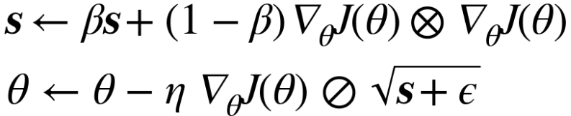
RMSProp
RMSProp actually fixes the problem of AdaGrad by accumulating gradients of only the most recent iterations
Hyperparameter 𝛽 is responsible for choosing the most recent gradients
Its value is defaulted as 0.9 and it works with this default value quite well
In neural network (and in many other situations) RMSProp works superior to AdaGrad

Slide 27
Adam Optimizer
Short form of “Adaptive Moment” Estimation
Keeps track of an exponentially decaying average of past gradients
Keeps track of an exponentially decaying average of past square gradient
Usually performs superior to other optimization technique

Slide 28
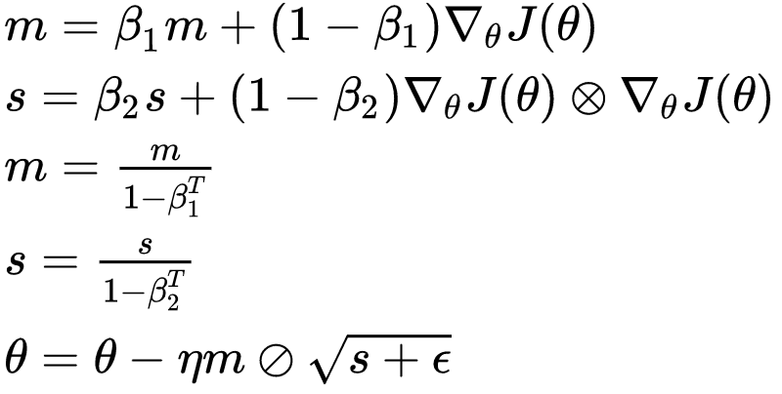
Adam Optimizer
T stands for iteration number (starting with 1)
m is momentum component and s is the scaling component
β₁ and β₂ are momentum decay hyperparameter and scaling decay hyperparameter
𝜂 is learning rate

Slide 29
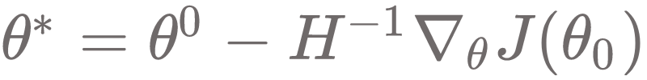
Approximate second order methods
Newton's’ Method
With locally quadratic function (with positive definite H), Newton’s method reaches minimum directly
If the objective function is convex but not quadratic, this update can be done iteratively
If H is not positive definite, Newton’s method can take updation in a wrong direction

Slide 30
Approximate second order methods
The problem of Newton’s method can be resolved by adding regularization to the Hessian
For extreme cases with high negative values in H, 𝜶 needs to be quite high which would eventually slow down the learning process below than that of gradient based process
H is required to be calculated in each training step which is a very computationally intensive task

Slide 31
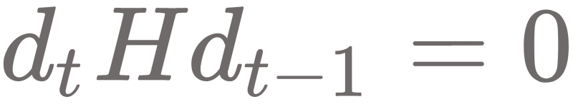
Conjugate gradient
It is a method which avoids the inverse calculation of Hessian by iteratively descending along conjugate directions
It is a modification of steepest descent algorithm
Steepest descent algorithm follows a zig-zag path to reach the minima
In quadratic surface, two directions d_{t} and d_{t-1} will be called conjugate if the following condition is satisfied

Slide 32
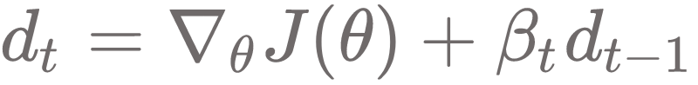
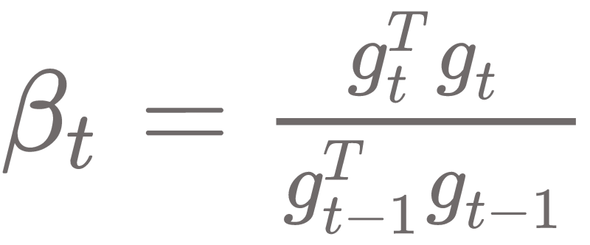
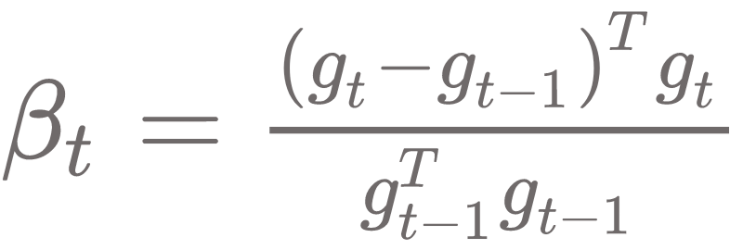
Conjugate gradient
In conjugate descent, the new direction is defined as
The parameter 𝛽 is computed as follows
In k dimensional parameter space, conjugate gradient method requires at most k line searches to achieve the minima
Fletcher-Reeves method
Polak-Ribiere method

Slide 33
Regularization
Plays critical role in generalizing neural network
Different Strategies:
Early Stopping
L1 and L2 Regularization
Dropout
Max Norm
Data Augmentation

Slide 34
Early Stopping
Early stopping is very easy to understand and is quite effective
Keep tracking the validation error
The moment validation error starts increasing, stop further training
Works very well in practice but when combined with other regularization technique, can produce much superior performance

Slide 35
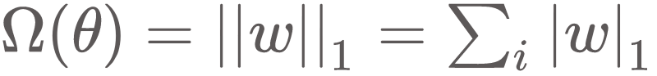
L1 Regularization
Cost function:
Source of problem

Slide 36
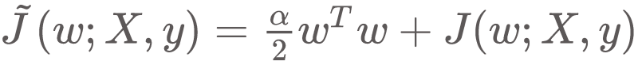
L2 Regularization
The cost function is modified as

Slide 37
Dropout regularization
This is the most popular regularization technique in DNN
During training a random set of links are simply ‘dropped’ out of any updation
Dropout training is somewhat similar to bagging training but there are specific differences:
In case of bagging, each model is independent of each other whereas in dropout training, parameter sharing happens and each model inherits parameters from its parent neural network
In bagging all models are trained to converge on its respective training set whereas in dropout training, a small sample of possible subnetworks are trained for a single step and parameter sharing helps remaining subnetworks to arrive at good setting of parameters

Slide 38
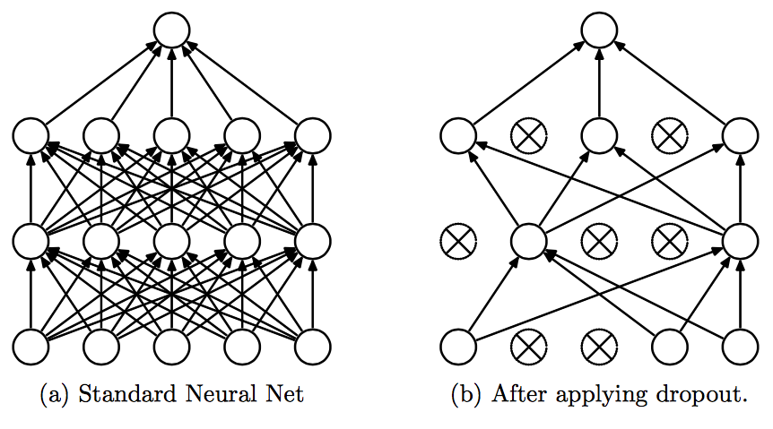
Dropout regularization
Most popular regularization technique in DNN
Very simple and yet very effective (little bit counter intuitive)
In general, at random, some of the nodes are simply dropped out (even from input nodes but not from output node)
Nodes got dropped out in one step may be active in another step
Once trained, no dropping happens during prediction
Usually dropout rate is defaulted to 0.5 (i.e. 50%). Sometimes, this rate may go up to even 70-75%

Slide 39
Max Norm Regularization
Another popular regularization technique in ANN
A max-norm hyperparameter is to be fixed (say R) such that for each incoming connection to a node, ||w||₂ < R where || . ||₂ is the L2 norm
Reducing the value of R makes the situation more constrained which improves generalization
This method can also help alleviating the vanishing/exploding gradient problem if batch normalization is not used

Slide 40
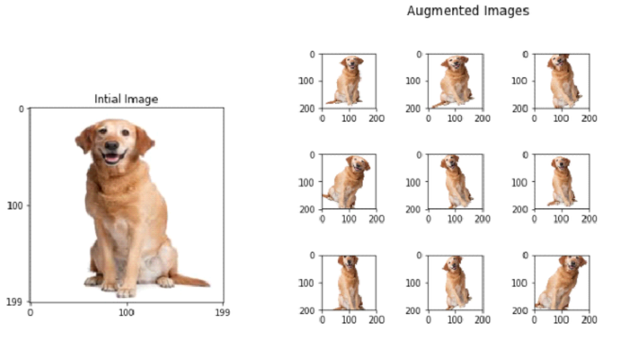
Data Augmentation
Consists of generating new training instances out of existing training samples, artificially boosting the training size
Helps in reducing overfitting
However, it is not just adding white noise because the augmentation must be done in such a way which can be learned
It is better to do data augmentation on the fly so as to avoid wasting too much of memory for storing the data in the physical memory. This method is particularly helpful in image mining

